Slide 1
Veterinary Medicine Infographics
Here is where this template begins

Slide 2
Veterinary Medicine Infographics
01
02
03
Mercury
Jupiter
Venus
Mercury is the closest planet to the Sun
Jupiter is the biggest planet of them all
Venus is the second planet from the Sun

Slide 3
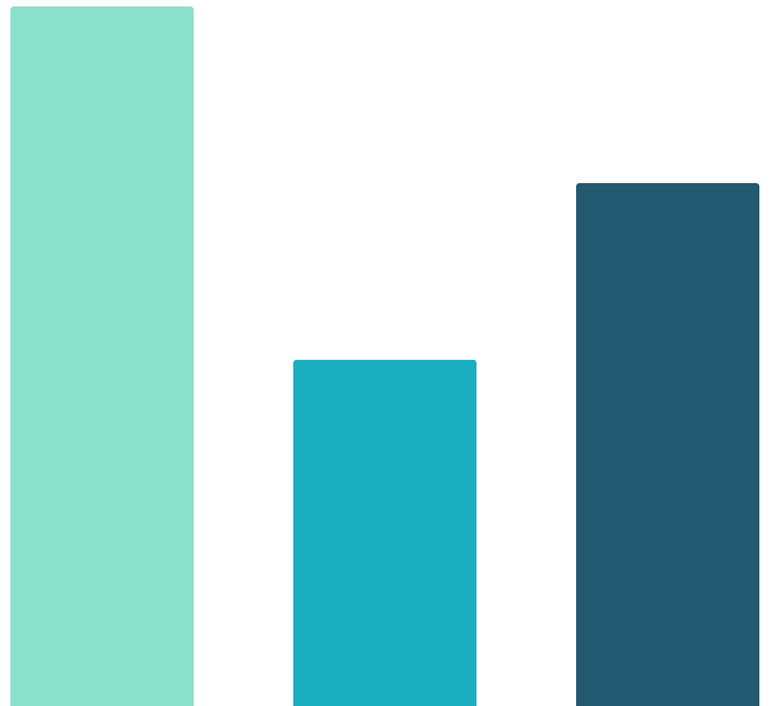
Veterinary Medicine Infographics
Neptune
100%
Neptune is the farthest planet from the Sun
Pluto
50 %
Pluto is now considered a dwarf planet
Mercury
75 %
Mercury is the closest planet to the Sun
Follow the link in the graph to modify its data and then paste the new one here. For more info, click here

Slide 4
Veterinary Medicine Infographics
Saturn
Saturn is a gas giant and is composed mostly of hydrogen and also helium
Jupiter
Mercury
01
02
Jupiter is the biggest planet of them all
Mercury is the closest planet to the Sun

Slide 5
Veterinary Medicine Infographics
01
Mars
Despite being red, Mars is a very cold place
Jupiter
02
Jupiter is the biggest planet of them all
03
Venus
Venus is the second planet from the Sun

Slide 6
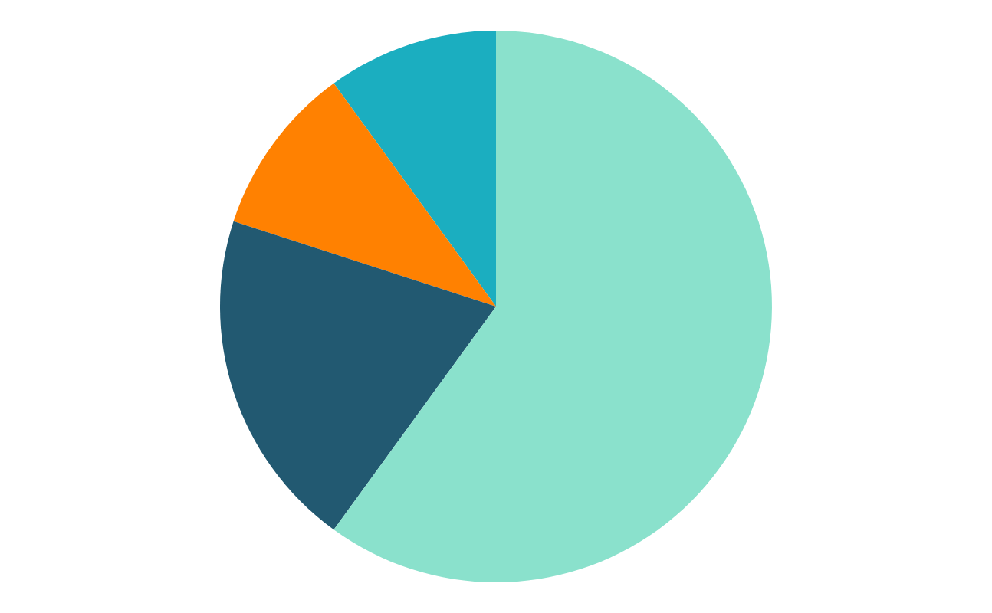
Veterinary Medicine Infographics
10 %
60 %
Mercury
Neptune
Mercury is the closest planet to the Sun
Neptune is the farthest planet from the Sun
10 %
20 %
Venus
Pluto
Venus has a beautiful name, but is hot
Pluto is now considered a dwarf planet
Follow the link in the graph to modify its data and then paste the new one here. For more info, click here

Slide 7
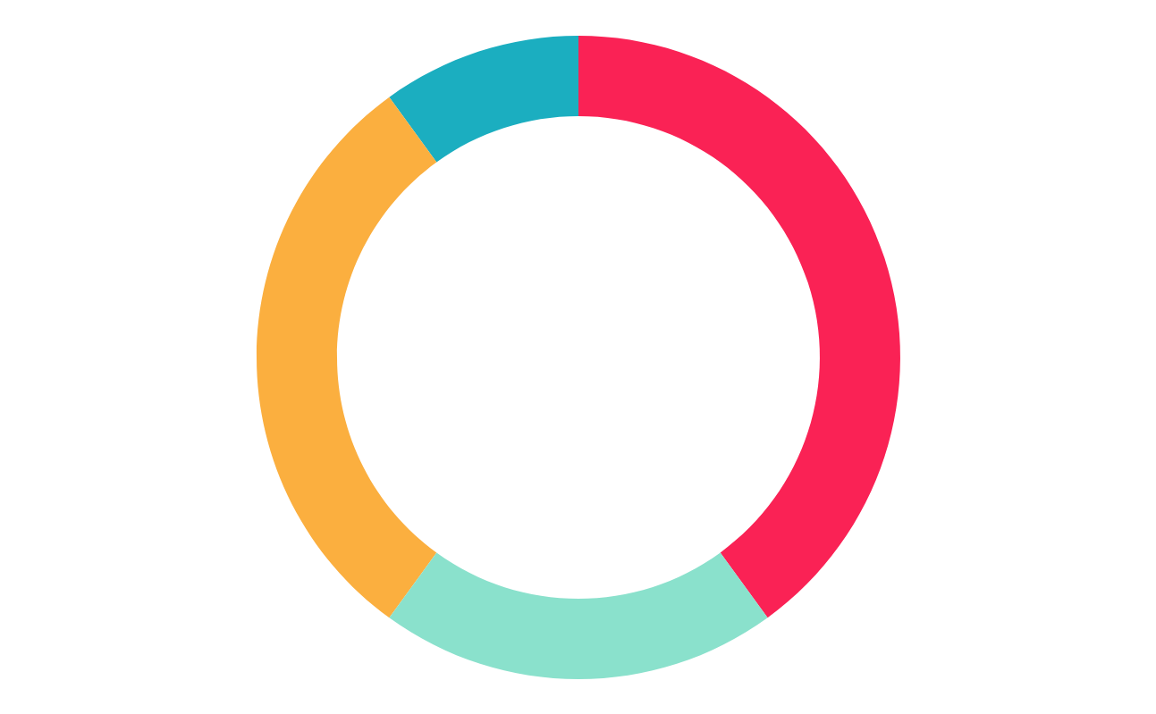
Veterinary Medicine Infographics
10 %
40 %
Mercury
Neptune
Mercury is the closest planet to the Sun
Neptune is the farthest planet from the Sun
30 %
20 %
Venus
Pluto
Venus has a beautiful name, but is hot
Pluto is now considered a dwarf planet
Follow the link in the graph to modify its data and then paste the new one here. For more info, click here

Slide 8
Veterinary Medicine Infographics
75%
70%
Jupiter
Mercury
Jupiter is the biggest planet in the entire Solar System
Mercury is the closest planet to the Sun

Slide 9
Veterinary Medicine Infographics
4/10
4/10
2/10
Neptune
Venus
Mars
Neptune is the farthest planet
Venus has a beautiful name
Despite being red, it is cold

Slide 10
Veterinary Medicine Infographics
Senior
1 | 2 | 3 | 4 | 5 | 6 | 7 | 8 | 9 | 10 | 11 | 12 | 13 | 14 | 15
Small
Mercury is the closest planet to the Sun
Senior
1 | 2 | 3 | 4 | 5 | 6 | 7 | 8 | 9 | 10 | 11 | 12 | 13 | 14 | 15
Medium
Venus has a beautiful name, but is hot
Senior
1 | 2 | 3 | 4 | 5 | 6 | 7 | 8 | 9 | 10 | 11 | 12 | 13 | 14 | 15
Large
Neptune is the farthest planet from the Sun

Slide 11
Veterinary Medicine Infographics
Mercury
Neptune
Mercury is the closest planet to the Sun
Neptune is the farthest planet
40 %
10 %
Venus
Pluto
Venus has a beautiful name, but is hot
It is now considered a dwarf planet
30 %
20 %

Slide 12
Veterinary Medicine Infographics
Dog Daily Feeding
Size |  | Weight | Cups | Size |  | Weight | Cups
Toy |  | 3 Lbs | 1/3 | Medium |  | 40 Lbs | 2 1/4
 |  | 6 Lbs | 1/2 |  |  | 50 Lbs | 2 2/3
 |  | 10 Lbs | 3/4 |  |  | 60 Lbs | 3
Small |  | 15 Lbs | 1 | Large |  | 70 Lbs | 3 1/2
 |  | 20 Lbs | 1 1/3 |  |  | 80 Lbs | 3 3/4
 |  | 30 Lbs | 1 3/4 |  |  | 90 Lbs | 4 1/4

Slide 13
Veterinary Medicine Infographics
01
02
03
04
Mercury
Mars
Jupiter
Venus
Mercury is the closest planet to the Sun
Despite being red, Mars is a cold planet
Jupiter is the biggest planet of them all
Venus has a beautiful name, but is hot

Slide 14
Veterinary Medicine Infographics
Mercury
01
Mercury is the closest planet to the Sun
Mars
Venus
01
Despite being red, Mars is a cold planet
Venus has a beautiful name, but is hot
Earth
01
Earth is the planet where we all live on

Slide 15
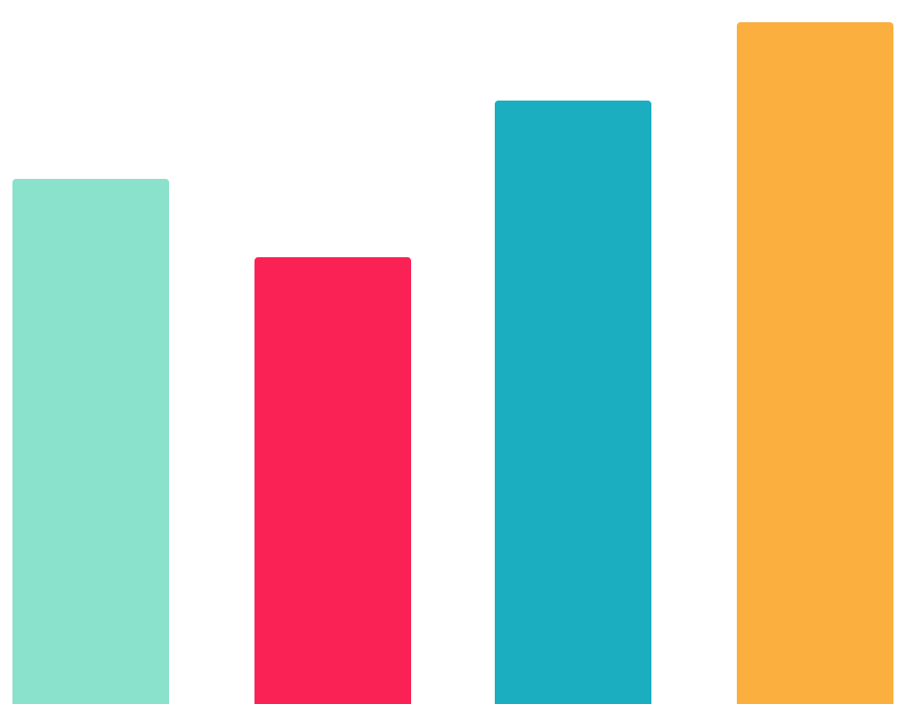
Veterinary Medicine Infographics
01
80 %
70 %
90 %
100 %
02
Mercury
Mars
Mercury is the closest planet to the Sun
Despite being red, Mars is a cold planet
03
04
Venus
Earth
Venus has a beautiful name, but is hot
Earth is the planet that harbors life
Follow the link in the graph to modify its data and then paste the new one here. For more info, click here

Slide 16
Veterinary Medicine Infographics
Mercury
Mars
01
02
Mercury is the closest planet to the Sun
Despite being red, Mars is a cold place
Venus
Jupiter
06
03
Venus has a beautiful name, but is hot
Jupiter is a gas giant and the biggest planet
Earth
Saturn
05
04
Earth is the third planet from the Sun
Saturn is a gas giant and has several rings

Slide 17
Veterinary Medicine Infographics
Mercury
Mars
Mercury is the smallest planet
Mars is a very cold planet
25 %
75 %
Jupiter
Jupiter is a gas giant and the biggest planet

Slide 18
Veterinary Medicine Infographics
65 %
45 %
Mars
Jupiter
Saturn
Despite being red, Mars is a cold place
Jupiter is a gas giant and the biggest planet
Saturn is a gas giant and has several rings

Slide 19
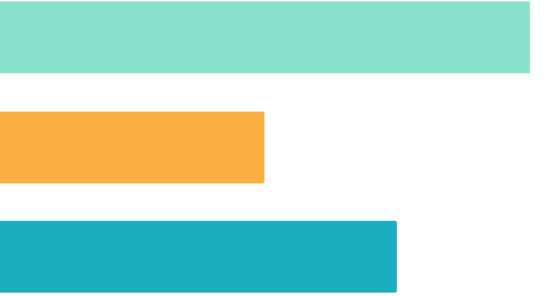
Veterinary Medicine Infographics
100 %
50 %
75 %
Mars
Jupiter
Saturn
Despite being red, Mars is a cold place
Jupiter is a gas giant and the biggest planet
Saturn is a gas giant and has several rings
Follow the link in the graph to modify its data and then paste the new one here. For more info, click here

Slide 20
Veterinary Medicine Infographics
Mercury
Neptune
01
02
Mercury is the closest planet to the Sun
Neptune is the farthest planet from the Sun
Venus
Pluto
03
04
Venus has a beautiful name, but is hot
Pluto is now considered a dwarf planet

Slide 21
Veterinary Medicine Infographics
01
Mercury
Mercury is the closest planet to the Sun
Earth
02
Earth is the planet that harbors life

Slide 22
Veterinary Medicine Infographics
02
03
Mercury
Venus
Mercury is the closest planet to the Sun
Venus is the second planet from the Sun
01
04
Jupiter
Saturn
Jupiter is the biggest planet of them all
Saturn is a gas giant with several rings

Slide 23
Veterinary Medicine Infographics
Venus
Mercury
Venus has a beautiful name, but is hot
Mercury is the closest planet to the Sun
30 %
40 %
Pluto
Neptune
Pluto is now considered a dwarf planet
Neptune is the farthest planet from the Sun
40 %
30 %

Slide 24
Veterinary Medicine Infographics
Mercury
Mercury is the closest planet to the Sun
Jupiter
Jupiter is the biggest planet of them all
Venus
Venus is the second planet from the Sun
Saturn
Saturn is a gas giant with several rings

Slide 25
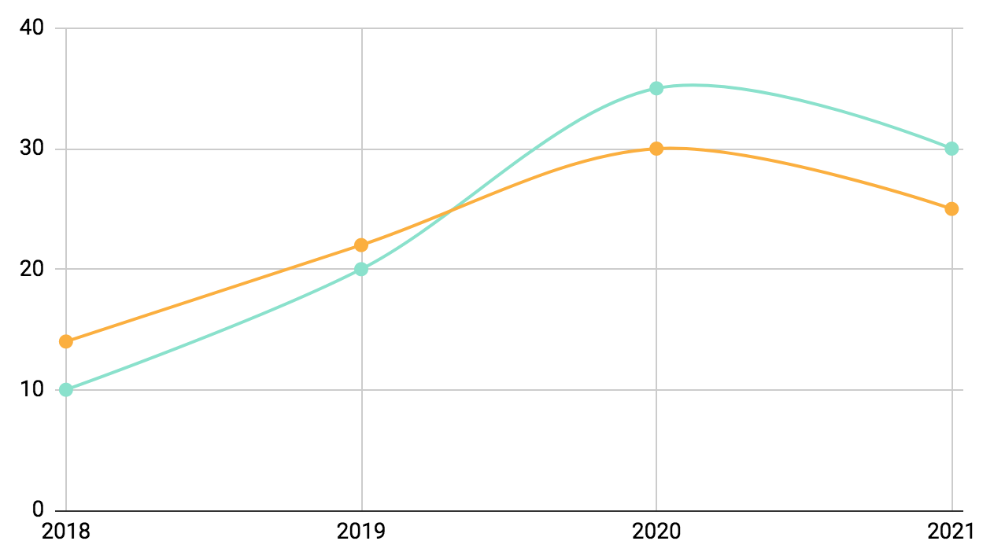
Veterinary Medicine Infographics
+25 %
Mars
Despite being red, Mars is a cold planet
+30 %
Mercury
Mercury is the closest planet to the Sun
Follow the link in the graph to modify its data and then paste the new one here. For more info, click here

Slide 26
Veterinary Medicine Infographics
Venus
Jupiter
Venus has a beautiful name, but is hot
Jupiter is a gas giant and the biggest planet
Saturn
Ceres
Saturn is a gas giant and has several rings
Ceres is located in the main asteroid belt

Slide 27
Veterinary Medicine Infographics
 | 5 Lbs | 10 Lbs | 15 Lbs | 20 Lbs
Kitten | 200 Kcal | 400 Kcal | 600 Kcal | 800 Kcal
Lean Cat | 170 Kcal | 280 Kcal | 360 Kcal | 440 Kcal
Overweight Cat | 180 Kcal | 240 Kcal | 280 Kcal | 310 Kcal
Pregnant Cat | 336 Kcal | 603 Kcal | 851 Kcal | 1091 Kcal

Slide 28
Veterinary Medicine Infographics
Venus
Mercury
Neptune
Venus has a beautiful name, but is hot
Mercury is the closest planet to the Sun
Neptune is the farthest planet from the Sun
01
02
03

Slide 29
Veterinary Medicine Infographics
Mercury
Venus
It is the closest planet to the Sun
Venus has a beautiful name, but is hot
20 %
10 %
40 %
30 %
Mars
Earth
Despite being red, Mars is a cold place
Earth is the third planet from the Sun

Slide 30
Veterinary Medicine Infographics
Venus
Mercury
Venus has a beautiful name, but is hot
Mercury is the closest planet to the Sun
Earth
Mars
Earth is the third planet from the Sun
Despite being red, Mars is a cold place

Slide 31
Veterinary Medicine Infographics
01
Mercury
03
Neptune
Mercury is the closest planet to the Sun
Neptune is the farthest planet from the Sun
Venus
Pluto
Venus has a beautiful name, but is hot
02
Pluto is now considered a dwarf planet
04

Slide 32
Veterinary Medicine Infographics
01
02
60 %
40 %
Neptune
Venus
Neptune is the farthest planet
Venus has a beautiful name

Slide 33
Instructions for use
In order to use this template, you must credit Slidesgo in your final presentation.
You are allowed to:
- Modify this template.
- Use it for both personal and commercial projects.
You are not allowed to:
- Sublicense, sell or rent any of Slidesgo Content (or a modified version of Slidesgo Content).
- Distribute Slidesgo Content unless it has been expressly authorized by Slidesgo.
- Include Slidesgo Content in an online or offline database or file.
- Offer Slidesgo templates (or modified versions of Slidesgo templates) for download.
- Acquire the copyright of Slidesgo Content.
For more information about editing slides, please read our FAQs or visit Slidesgo School:
https://slidesgo.com/faqs and https://slidesgo.com/slidesgo-school

Slide 34
Instructions for use (premium users)
In order to use this template, you must be a Premium user on Slidesgo.
You are allowed to:
Modify this template.
Use it for both personal and commercial purposes.
Hide or delete the “Thanks” slide and the mention to Slidesgo in the credits.
Share this template in an editable format with people who are not part of your team.
You are not allowed to:
Sublicense, sell or rent this Slidesgo Template (or a modified version of this Slidesgo Template).
Distribute this Slidesgo Template (or a modified version of this Slidesgo Template) or include it in a database or in any other product or service that offers downloadable images, icons or presentations that may be subject to distribution or resale.
Use any of the elements that are part of this Slidesgo Template in an isolated and separated way from this Template.
Register any of the elements that are part of this template as a trademark or logo, or register it as a work in an intellectual property registry or similar.
For more information about editing slides, please read our FAQs or visit Slidesgo School:
https://slidesgo.com/faqs and https://slidesgo.com/slidesgo-school

Slide 35
Infographics
You can add and edit some infographics to your presentation to present your data in a visual way.
Choose your favourite infographic and insert it in your presentation using Ctrl C + Ctrl V or Cmd C + Cmd V in Mac.
Select one of the parts and ungroup it by right-clicking and choosing “Ungroup”.
Change the color by clicking on the paint bucket.
Then resize the element by clicking and dragging one of the square-shaped points of its bounding box (the cursor should look like a double-headed arrow). Remember to hold Shift while dragging to keep the proportions.
Group the elements again by selecting them, right-clicking and choosing “Group”.
Repeat the steps above with the other parts and when you’re done editing, copy the end result and paste it into your presentation.
Remember to choose the “Keep source formatting” option so that it keeps the design. For more info, please visit Slidesgo School.

